Slide 1
One hidden layer
Neural Network
Neural Networks
Overview

Slide 2







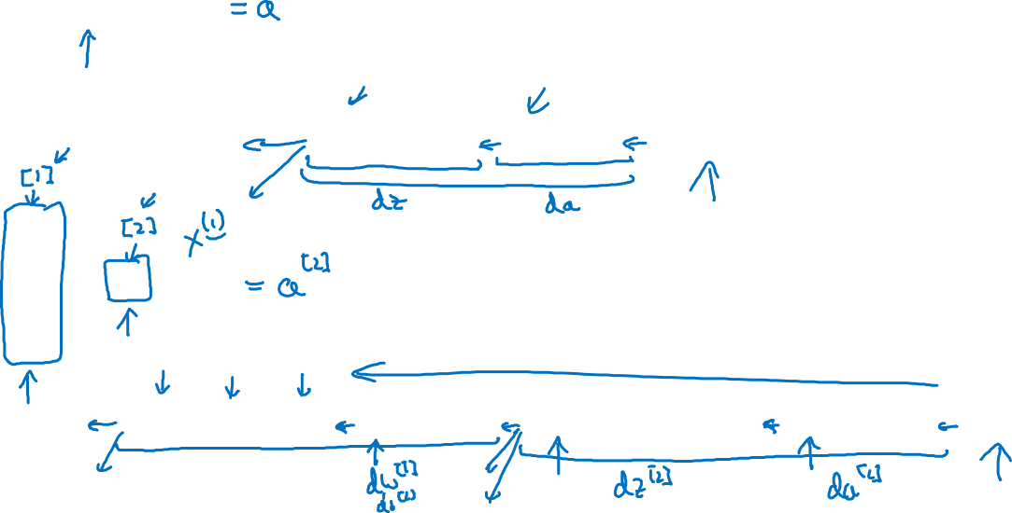





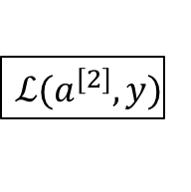







What is a Neural Network?
$$x_{1}$$
$$x_{2}$$
$$\hat{y}$$
$$x_{3}$$
x
w
$$z=w^{T}x+b$$
$$a=σ(z)$$
$$ℒ(a,y)$$
b
$$x_{1}$$
$$x_{2}$$
$$\hat{y}$$
$$x_{3}$$
x
$$W^{[1]}$$
$$z^{[1]}=W^{[1]}x+b^{[1]}$$
$$a^{[1]}=σ(z^{[1]})$$
$$z^{[2]}=W^{[2]}a_{ }^{[1]}+b^{[2]}$$
$$a^{[2]}=σ(z^{[2]})$$
$$ℒ(a^{[2]},y)$$
$$b^{[1]}$$
$$W^{[2]}$$
$$b^{[2]}$$

Slide 3
One hidden layer
Neural Network
Neural Network
Representation

Slide 4


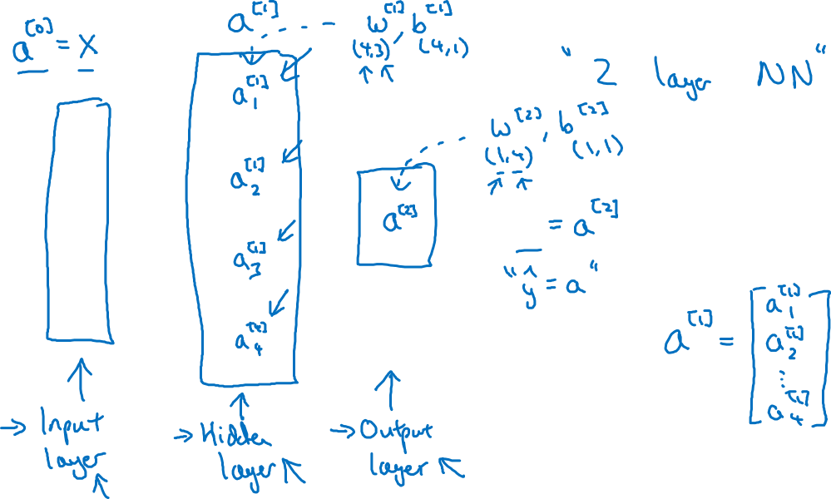


Neural Network Representation
$$x_{1}$$
$$x_{2}$$
$$\hat{y}$$
$$x_{3}$$

Slide 5
One hidden layer
Neural Network
Computing a
Neural Network’s
Output

Slide 6











Neural Network Representation
$$x_{1}$$
$$x_{1}$$
$$x_{2}$$
$$σ(z)$$
$$a=\hat{y}$$
$$x_{2}$$
$$\hat{y}$$
$$w^{T}x+b$$
$$z$$
$$a$$
$$x_{3}$$
$$x_{3}$$
$$z=w^{T}x+b$$
$$a=σ(z)$$

Slide 7

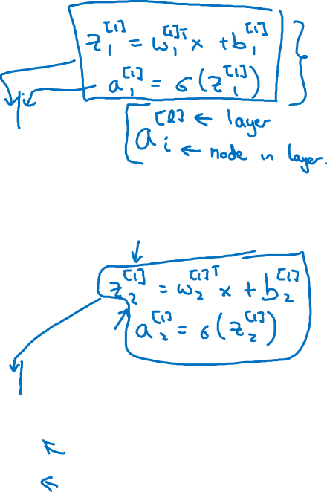





Neural Network Representation
$$x_{1}$$
$$x_{1}$$
$$x_{2}$$
$$σ(z)$$
$$a=\hat{y}$$
$$x_{2}$$
$$\hat{y}$$
$$w^{T}x+b$$
$$z$$
$$a$$
$$x_{3}$$
$$x_{3}$$
$$z=w^{T}x+b$$
$$x_{1}$$
$$a=σ(z)$$
$$x_{2}$$
$$\hat{y}$$
$$x_{3}$$

Slide 8

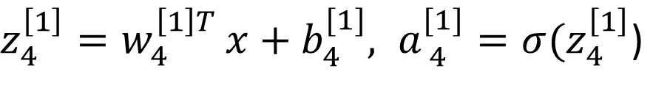


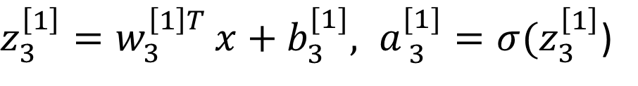


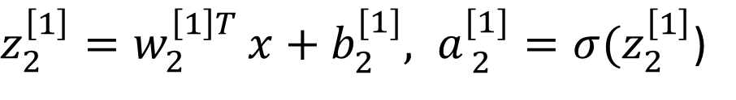

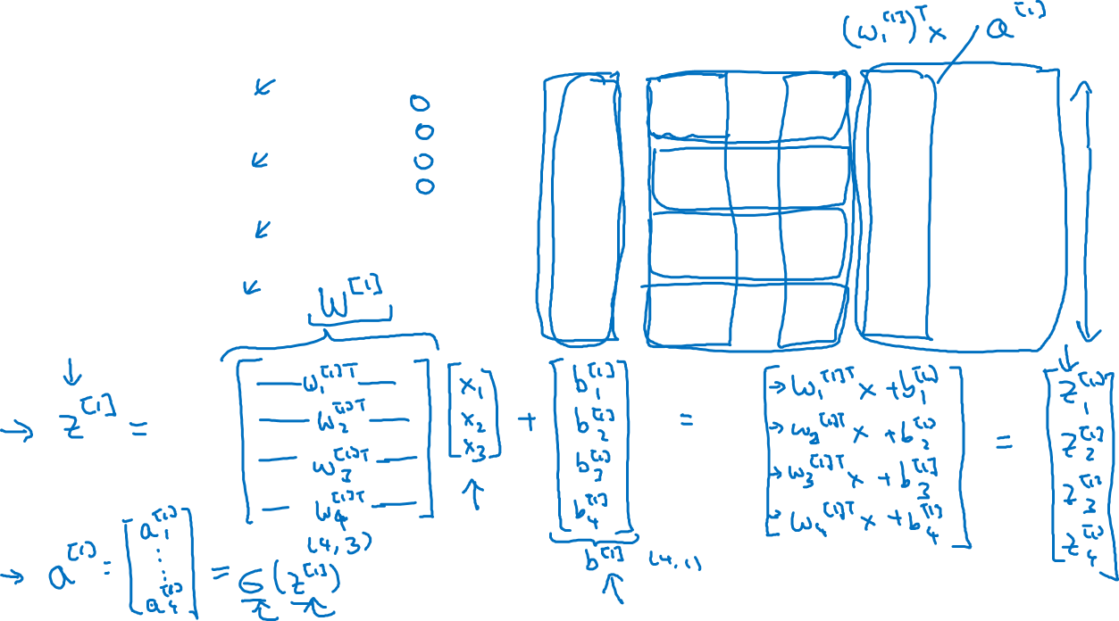
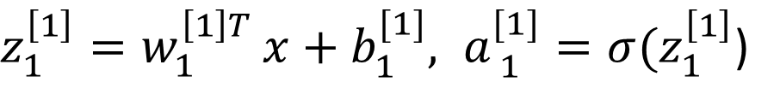


Neural Network Representation
$$a_{1}^{\left[1\right]}$$
$z_{1}^{\left[1\right]}=w_{1}^{{\left[1\right]T}^{ }}x+b_{1}^{[1]}, a_{ 1}^{[1]}=σ(z_{1}^{\left[1\right]}$)
$$x_{1}$$
$$a_{2}^{\left[1\right]}$$
$z_{2}^{\left[1\right]}=w_{2}^{{\left[1\right]T}^{ }}x+b_{2}^{[1]}, a_{ 2}^{[1]}=σ(z_{2}^{\left[1\right]}$)
$$x_{2}$$
$$\hat{y}$$
$$a_{3}^{\left[1\right]}$$
$z_{3}^{\left[1\right]}=w_{3}^{{\left[1\right]T}^{ }}x+b_{3}^{[1]}, a_{ 3}^{[1]}=σ(z_{3}^{\left[1\right]}$)
$$x_{3}$$
$$a_{4}^{\left[1\right]}$$
$z_{4}^{\left[1\right]}=w_{4}^{{\left[1\right]T}^{ }}x+b_{4}^{[1]}, a_{ 4}^{[1]}=σ(z_{4}^{\left[1\right]}$)

Slide 9



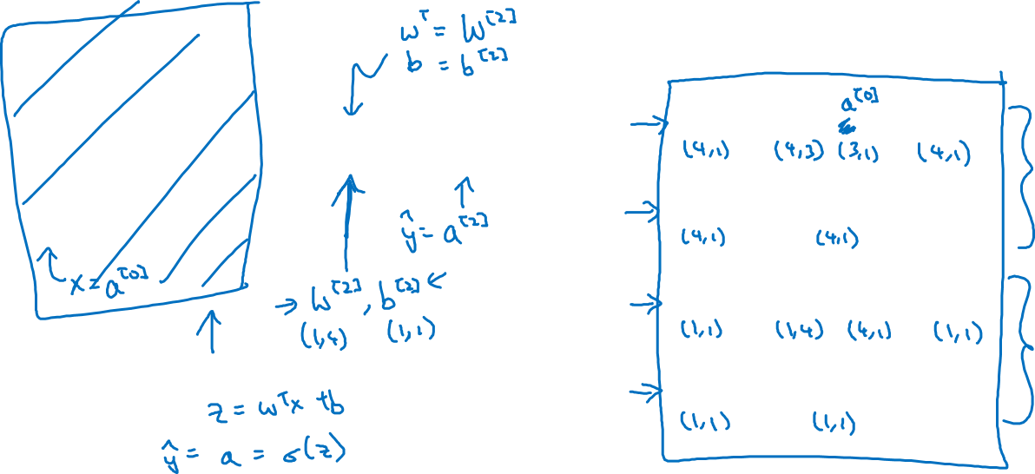

Neural Network Representation learning
$$a_{1}^{\left[1\right]}$$
Given input x:
$$x_{1}$$
$$a_{2}^{\left[1\right]}$$
$$z^{\left[1\right]}=W^{\left[1\right]}x+b^{\left[1\right]}$$
$$x_{2}$$
$$\hat{y}$$
$$a_{3}^{\left[1\right]}$$
$$x_{3}$$
$$a^{\left[1\right]}=σ(z^{\left[1\right]})$$
$$a_{4}^{\left[1\right]}$$
$$z^{\left[2\right]}=W^{\left[2\right]}a^{\left[1\right]}+b^{\left[2\right]}$$
$$a^{\left[2\right]}=σ(z^{\left[2\right]})$$

Slide 10
One hidden layer
Neural Network
Vectorizing across
multiple examples

Slide 11




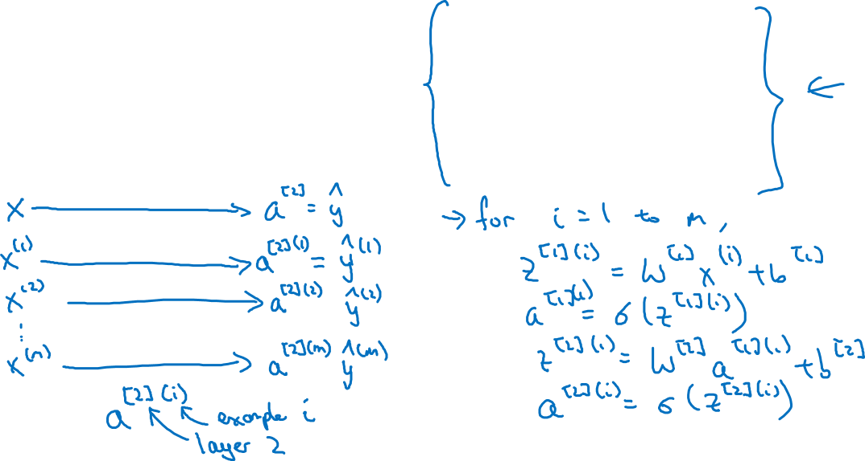

Vectorizing across multiple examples
$$z^{\left[1\right]}=W^{\left[1\right]}x+b^{\left[1\right]}$$
$$x_{1}$$
$$a^{\left[1\right]}=σ(z^{\left[1\right]})$$
$$x_{2}$$
$$\hat{y}$$
$$z^{\left[2\right]}=W^{\left[2\right]}a^{\left[1\right]}+b^{\left[2\right]}$$
$$x_{3}$$
$$a^{\left[2\right]}=σ(z^{\left[2\right]})$$

Slide 12
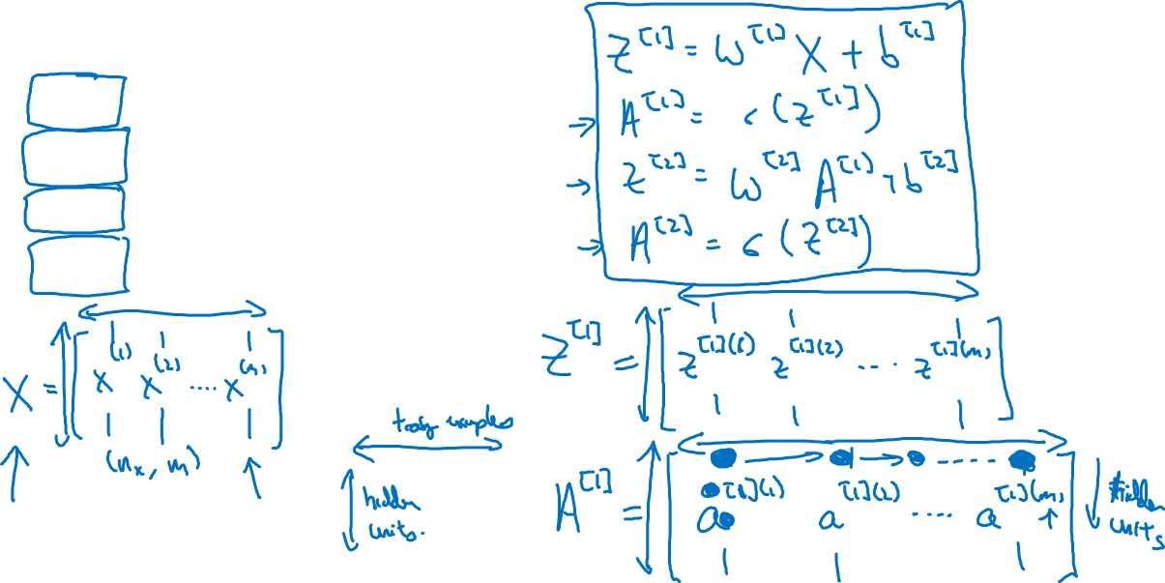




Vectorizing across multiple examples
for i = 1 to m:
$$z^{\left[1\right](i)}=W^{\left[1\right]}x^{(i)}+b^{\left[1\right]}$$
$$a^{\left[1\right](i)}=σ(z^{\left[1\right]\left(i\right)})$$
$$z^{\left[2\right](i)}=W^{\left[2\right]}a^{\left[1\right](i)}+b^{\left[2\right]}$$
$$a^{\left[2\right](i)}=σ(z^{\left[2\right]\left(i\right)})$$

Slide 13
One hidden layer
Neural Network
Activation functions

Slide 14




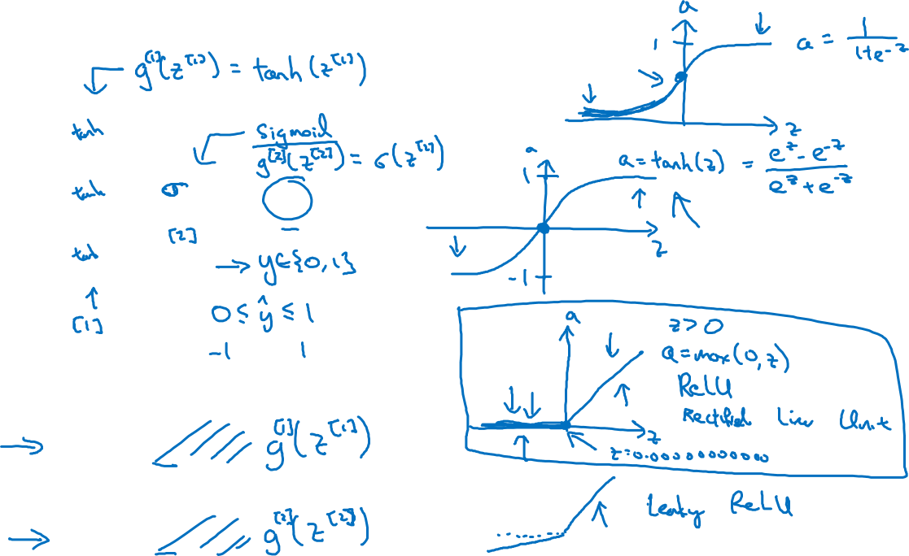


Activation functions
$$x_{1}$$
$$x_{2}$$
$$\hat{y}$$
$$x_{3}$$
Given x:
$$z^{\left[1\right]}=W^{\left[1\right]}x+b^{\left[1\right]}$$
$$a^{\left[1\right]}=σ(z^{\left[1\right]})$$
$$z^{\left[2\right]}=W^{\left[2\right]}a^{\left[1\right]}+b^{\left[2\right]}$$
$$a^{\left[2\right]}=σ(z^{\left[2\right]})$$

Slide 15
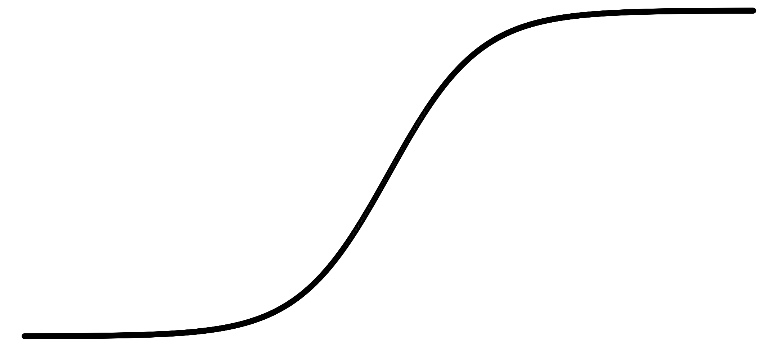
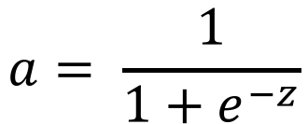
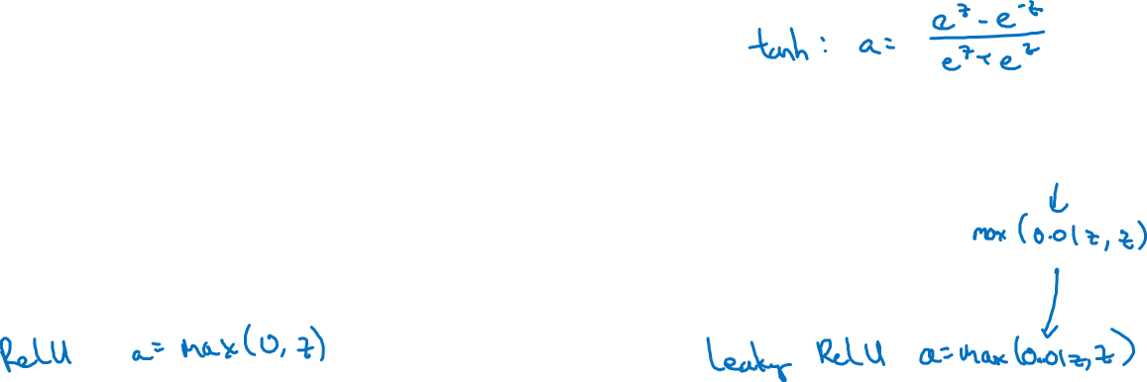
Pros and cons of activation functions
a
a
x
z
$$a= \frac{1}{1+e^{−z}}$$
sigmoid:
a
a
z
z

Slide 16
One hidden layer
Neural Network
Why do you
need non-linear
activation functions?

Slide 17



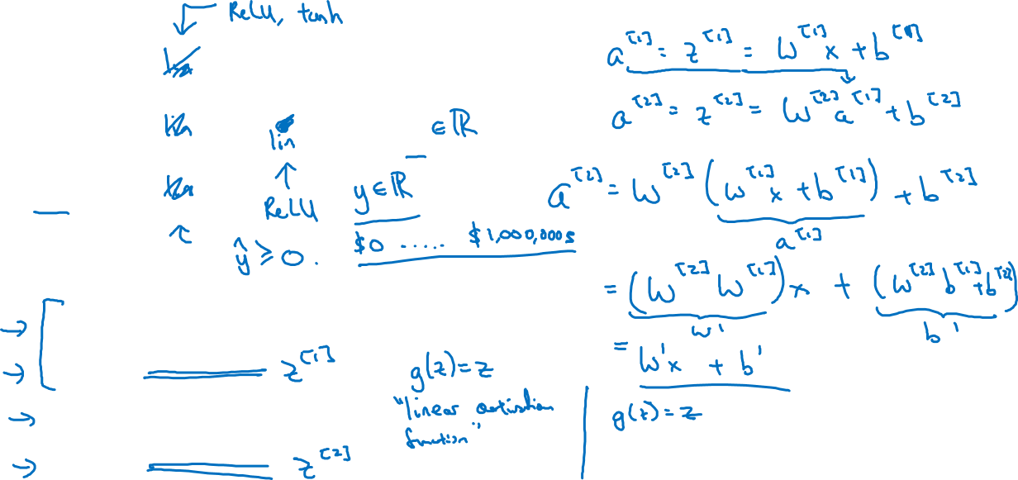



Activation function
$$x_{1}$$
$$x_{2}$$
$$\hat{y}$$
$$x_{3}$$
Given x:
$$z^{\left[1\right]}=W^{\left[1\right]}x+b^{\left[1\right]}$$
$$a^{\left[1\right]}=g^{[1]}(z^{\left[1\right]})$$
$$z^{\left[2\right]}=W^{\left[2\right]}a^{\left[1\right]}+b^{\left[2\right]}$$
$$a^{\left[2\right]}=g^{[2]}(z^{\left[2\right]})$$

Slide 18
One hidden layer
Neural Network
Gradient descent for
neural networks

Slide 19
Computing gradients
Logistic regression
$$x$$
$$w$$
$$z=w^{T}x+b$$
$$a= σ(z)$$
$$ℒ(a,y)$$
$$b$$

Slide 20
Neural network gradients
$$W^{[2]}$$
$$x$$
$$b^{[2]}$$
$$W^{[1]}$$
$$z^{[1]}=W^{[1]}x+b^{[1]}$$
$$a^{[1]}= σ(z^{[1]})$$
$$z^{[2]}=W^{[2]}x+b^{[2]}$$
$$a^{[2]}= σ(z^{[2]})$$
$$ℒ(a^{[2]},y)$$
$$b^{[1]}$$

Slide 21
Summary of gradient descent
$$dz^{[2]}=a^{[2]}−y$$
$$dZ^{[2]}=A^{[2]}−Y$$
$$dW^{[2]}=dz^{[2]}a^{{\left[1\right]}^{T}}$$
$$dW^{[2]}=\frac{1}{m}dZ^{[2]}A^{{\left[1\right]}^{T}}$$
$$db^{[2]}=dz^{[2]}$$
$$db^{[2]}=\frac{1}{m}np.sum(dZ^{\left[2\right]},axis=1, keepdims=True)$$
$$dz^{[1]}=W^{\left[2\right]T}dz^{[2]}∗g^{[1]}′(z^{\left[1\right]})$$
$$dZ^{[1]}=W^{\left[2\right]T}dZ^{[2]}∗g^{[1]}′(Z^{\left[1\right]})$$
$$dW^{[1]}=dz^{[1]}x^{T}$$
$$dW^{[1]}=\frac{1}{m}dZ^{[1]}X^{T}$$
$$db^{[1]}=dz^{[1]}$$
$$db^{[1]}=\frac{1}{m}np.sum(dZ^{\left[1\right]},axis=1, keepdims=True)$$

Slide 22
One hidden layer
Neural Network
Random Initialization

Slide 23






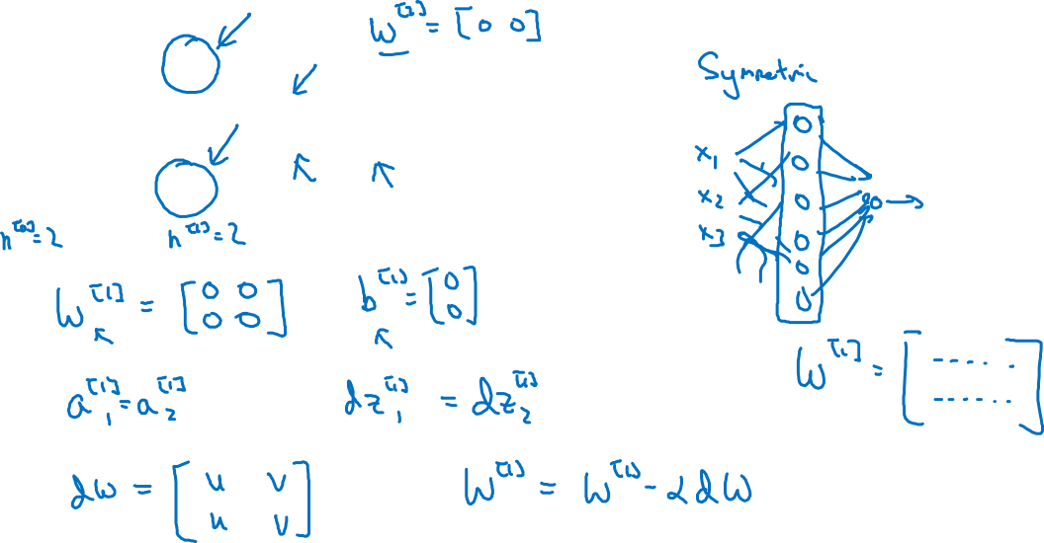
What happens if you initialize weights to zero?
$$x_{1}$$
$$a_{1}^{[1]}$$
$$a_{1}^{[2]}$$
$$\hat{y}$$
$$x_{2}$$
$$a_{2}^{[1]}$$

Slide 24
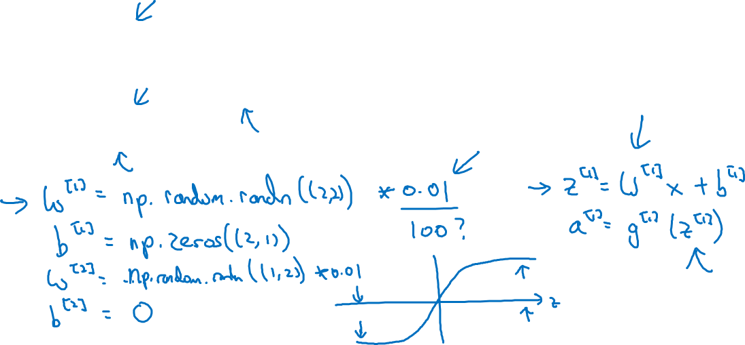
Random initialization
$$x_{1}$$
$$a_{1}^{[1]}$$
$$a_{1}^{[2]}$$
$$\hat{y}$$
$$x_{2}$$
$$a_{2}^{[1]}$$

Slide 25

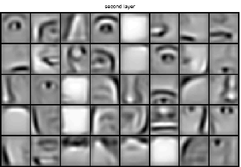
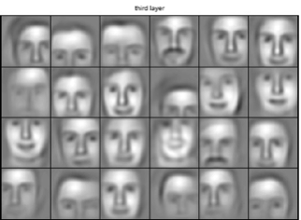

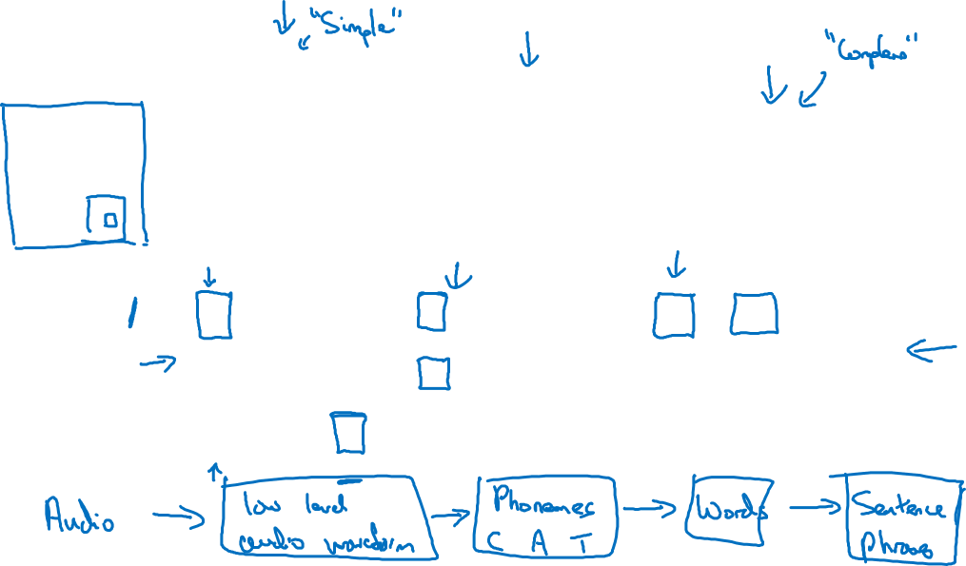
Intuition about deep representation
$$\hat{y}$$

Slide 26
Deep Neural Networks
Forward and backward
propagation

Slide 27
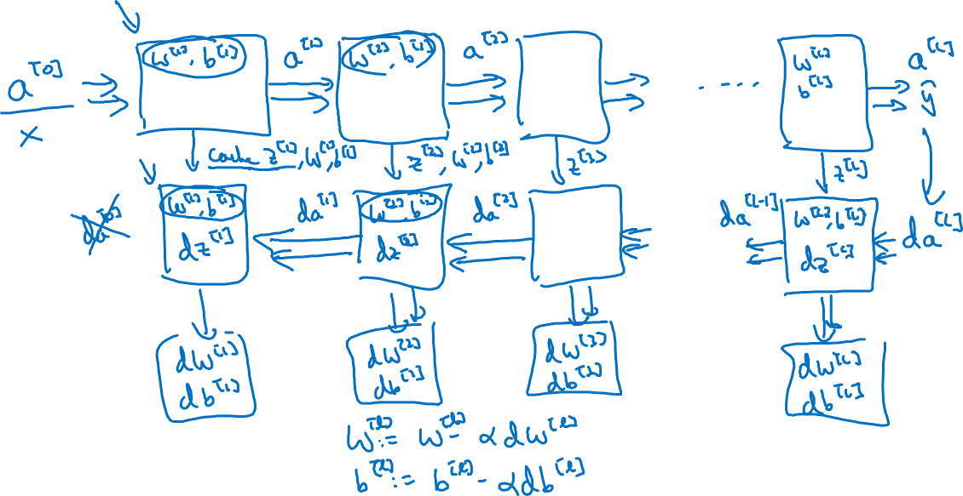
Forward and backward functions

Slide 28
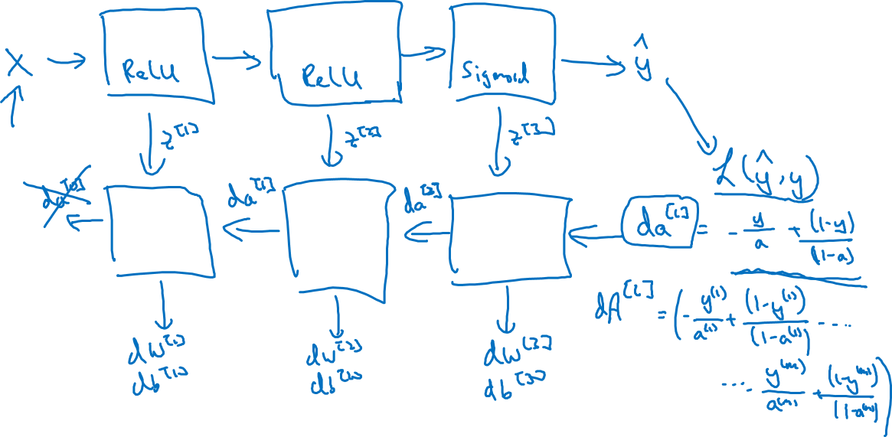
Summary

